Slide 1
ENSE 470 milestone 4
Jeremy Cross
Iden Ellia
Abdullah Alasmari

Slide 2
Database Snapshot
Briefly go over (display) your group’s database and schema (light)
Type of database selected (read/write csv, MySQL/SQL, PostgreSQL,…)
Database blueprint / organization of data (tables, rows, columns)
Discuss your group’s experience in cleansing the data
Issues that arose (if any)?
Innovative methods for data cleansing?
Etc.

Slide 3
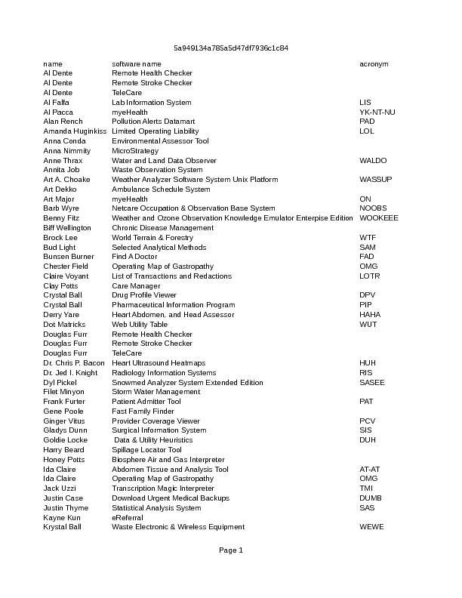
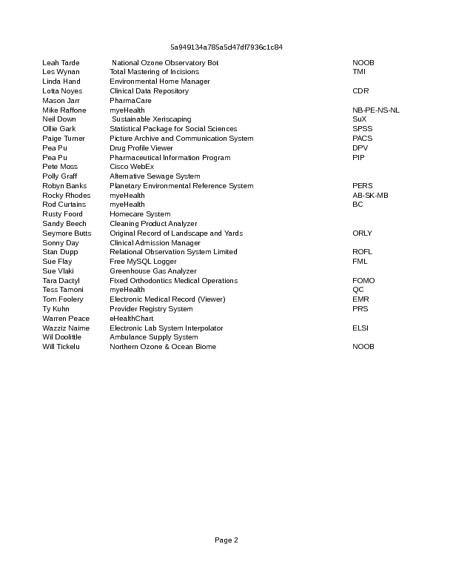

Slide 4
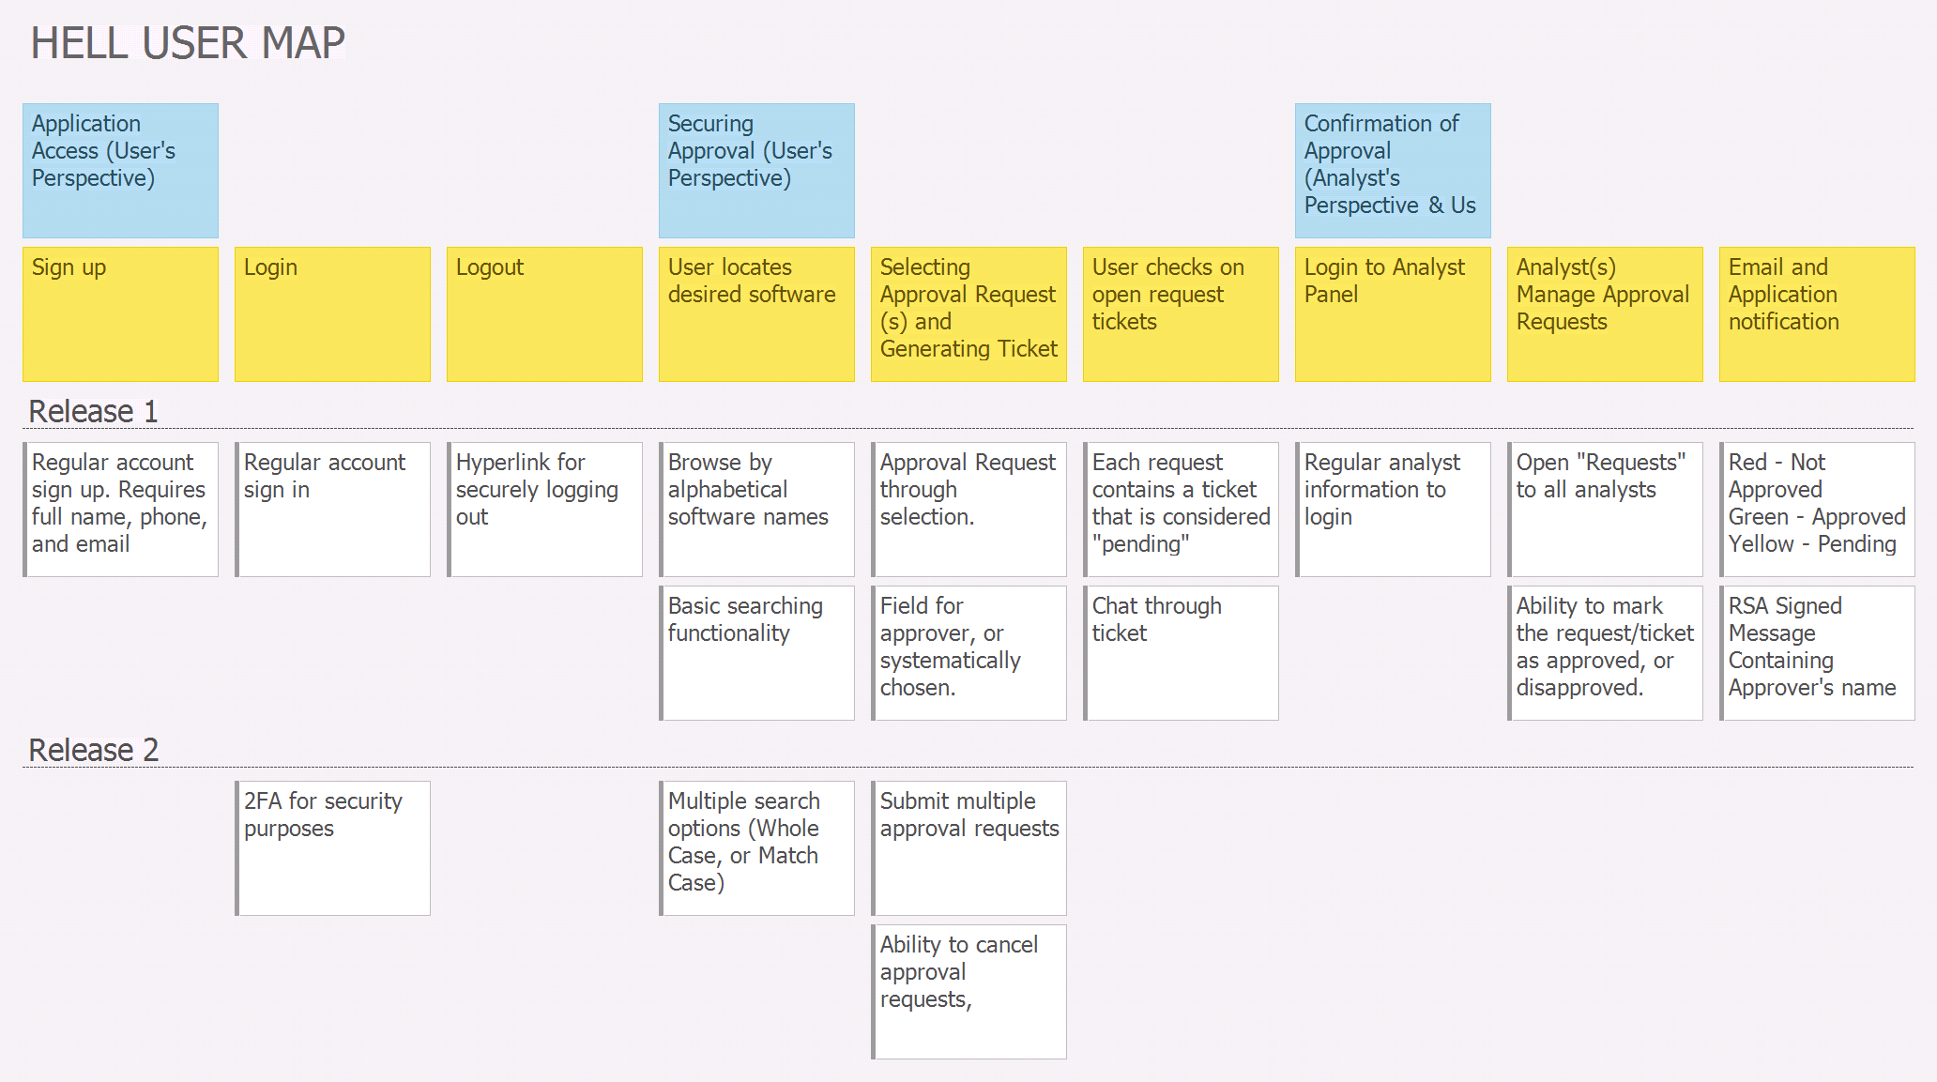
User story map

Slide 5
Lo-fidelity prototype snapshots
Go through the lo-fi prototype snapshots for all user activities for your release 1
Illustrate interactions
Illustrate messaging and data flows
NOTE: Try to show all / as much as you can, but be cognizant of your time
Describe your experience in creating the lo-fi prototype
Technology used? (white board, paper/pencil, digital)
Pros/Cons you experienced

Slide 6
Changes and misc
Have your plans changed since your group’s initial conception and project evolution
Something you saw another team did was intriguing/inspiring
Something you didn’t care for in your initial concept of your future VSM
Add other insights if you like but remember, your group’s report-out must be kept within 5 minutes

Slide 7
Group reflection
How did you feel about this milestone? What did you like about it? What did you dislike?
[Response here]
What did you learn about yourself as you collaborated and worked through this milestone?
[Response here]
How will you use what you have learned going forward?
[Response here]
What “stuff & things” related to this milestone would you want help with?
[Response here]

Slide 8
Questions?

